Slide 1

AskChanges
The iOS app of Changes

Slide 2
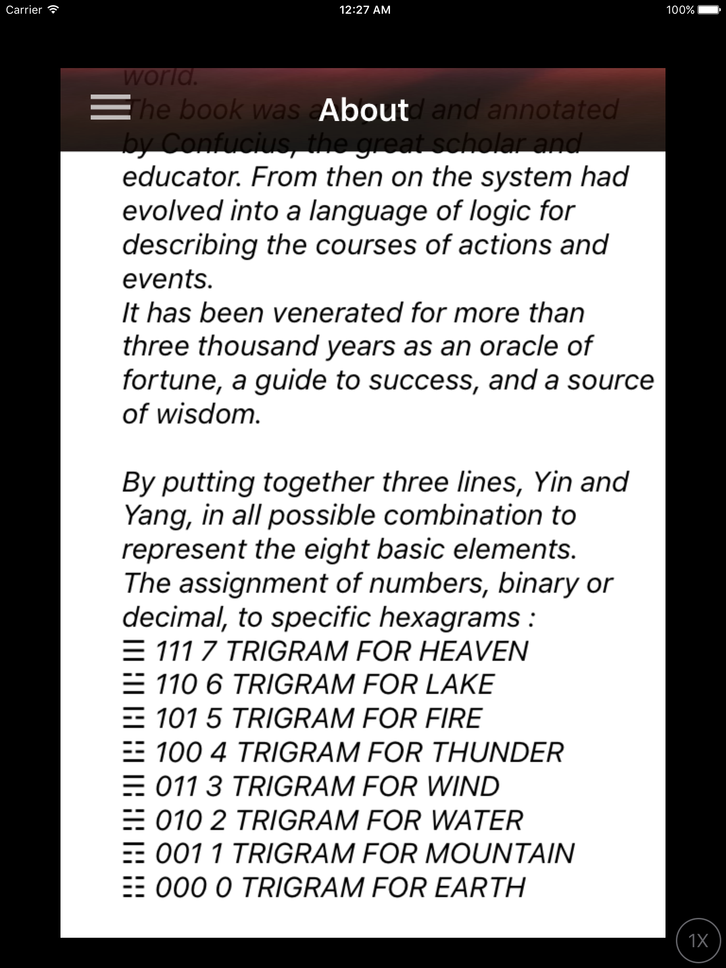

Slide 3
Introduction
Book of Change is oldest of the Chinese Classics, famous with its yin-yang theory, the idea that any can be described in terms of two basic elements is beautiful in its simplicity and forms the foundation from which the yin-yang theory was constructed.
The book was analyzed and annotated by Confucius, the great scholar and educator. From then on the system had evolved into a language of logic for describing the courses of actions and events.
It has been venerated for more than three thousand years as an oracle of fortune, a guide to success, and a source of wisdom.
By putting together three lines, Yin and Yang, in all possible combination to represent the eight basic elements.
With there eight elements as building blocks, a higher level of representation was achieved by stacking trigrams upon trigrams, creating the Sixty-four Hexagrams.

Slide 4
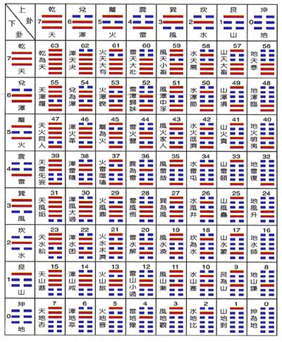
Conventions used in this app
Trigram/Image/Decimal/Binary
☰ sky 7 111
☴ wind 6 011
☲ fire 5 101
☶ mountain 4 001
☱ lake 3 110
☵ water 2 010
☳ thunder 1 100
☷ earth 0 000

Slide 5
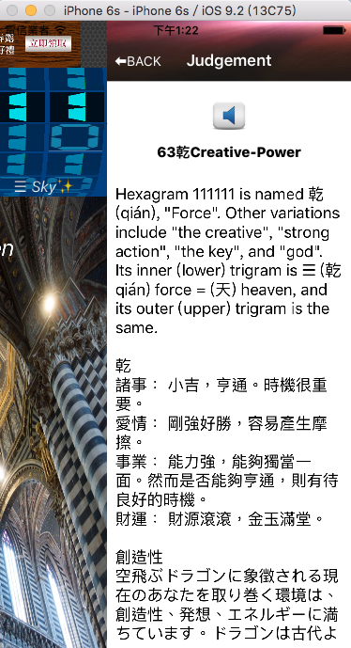
ViewController
Symbols Assigned as
Broken line 0 (binary)
Solid line 1 (binary)
Complementary trigrams shall mean two trigrams whose decimal sum is 7.
Complementary hexagrams are the two hexagrams that add up to 63 in decimal value.

Slide 6
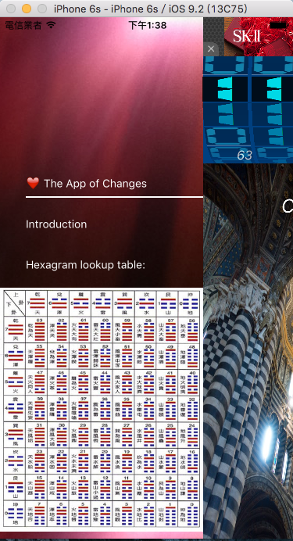

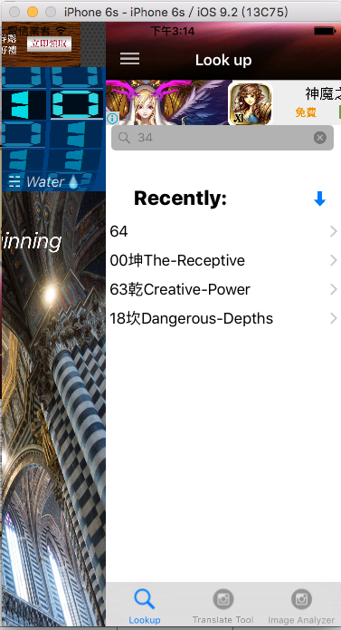
SlidingPannelController
Clean and easy to use UI

Slide 7
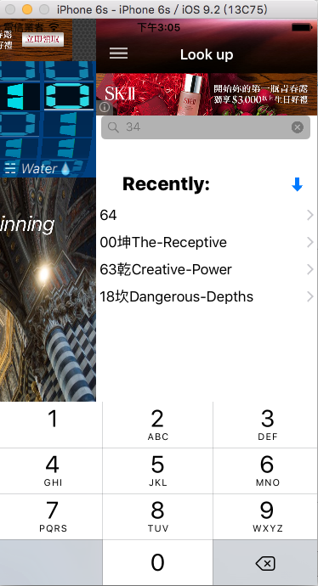
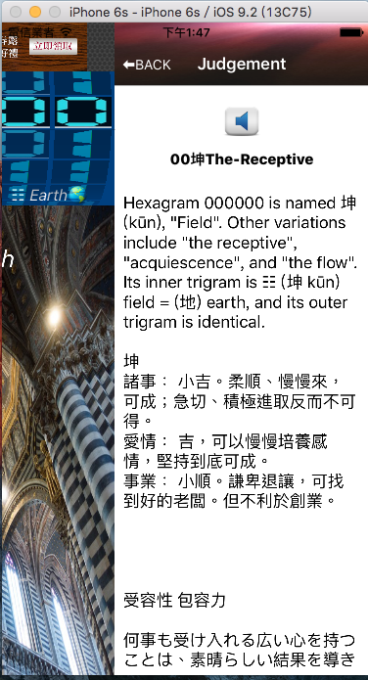
MeaningViewController
Allow user to quickly look up judgment in just one tap. History tab list Hexagrams recently looked up.

Slide 8
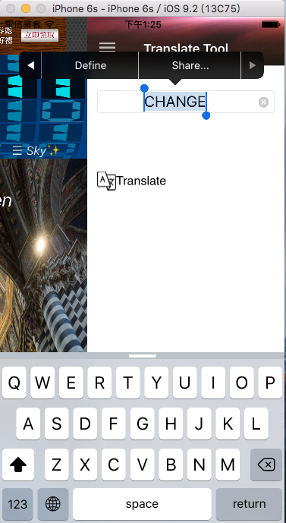
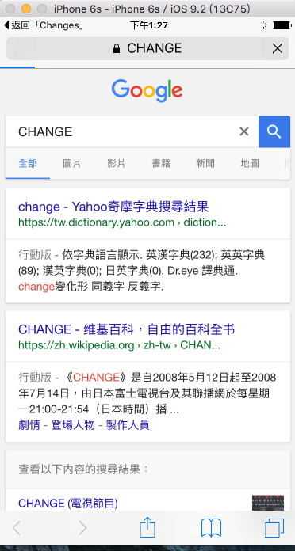
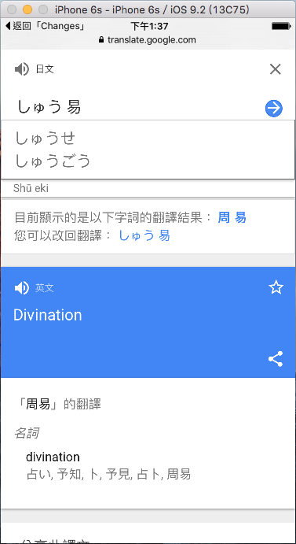
Translate Tool
Google’s free online language translation service

Slide 9
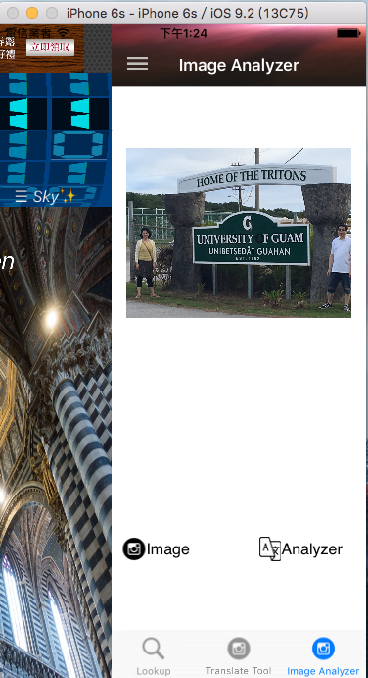
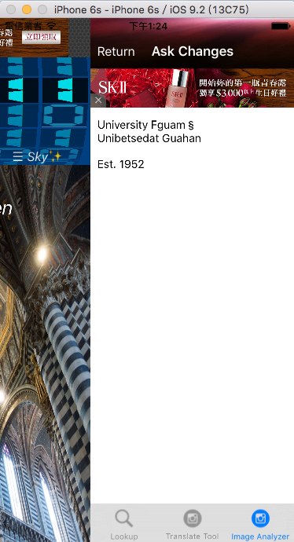
Image Analyzer
Supports use camera to translate picture to a whole English text

Slide 10

Thank You for purchasing
The app of Changes
In any matter, there are positive and negative factors.
As the sun gives place to the moon, and the moon to the sun, so is change always proceeding in the phenomena of nature and the experiences of society.
The idea that any can be described in terms of two basic elements is beautiful in its simplicity and forms the foundation from which the yin-yang theory was constructed.
The theory has been influencing all aspects of life from business and politics to personal relationships.

